Slide 1


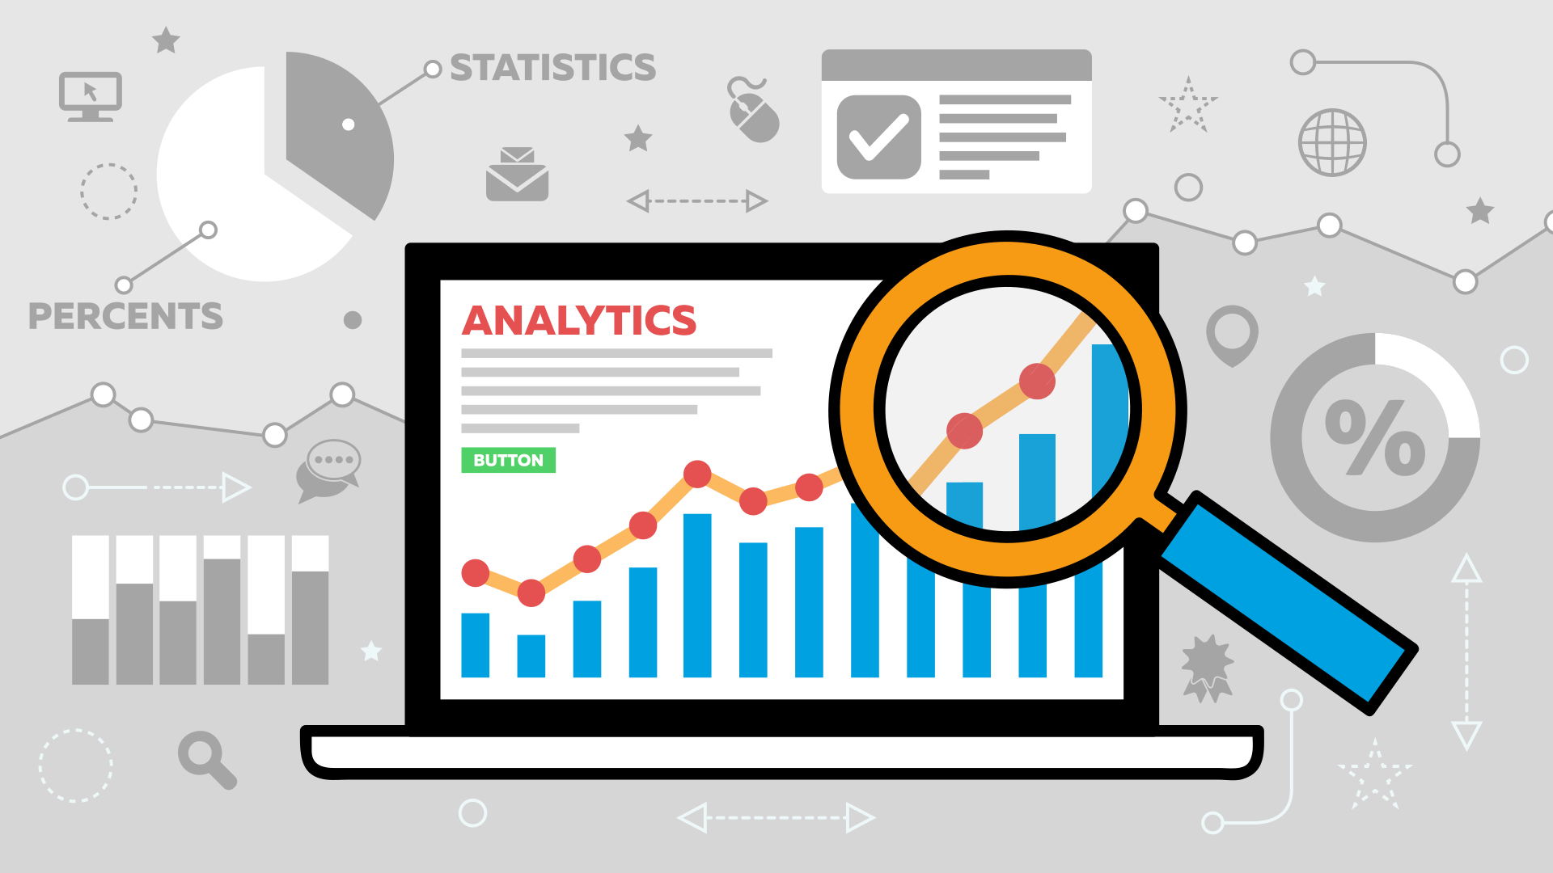
ANALYTICS DASHBOARD

